Slide 1
Heemod: time-varying values
Ivy Tsai
20231031

Slide 2
1. Review simple Markov model of HIV

Slide 3
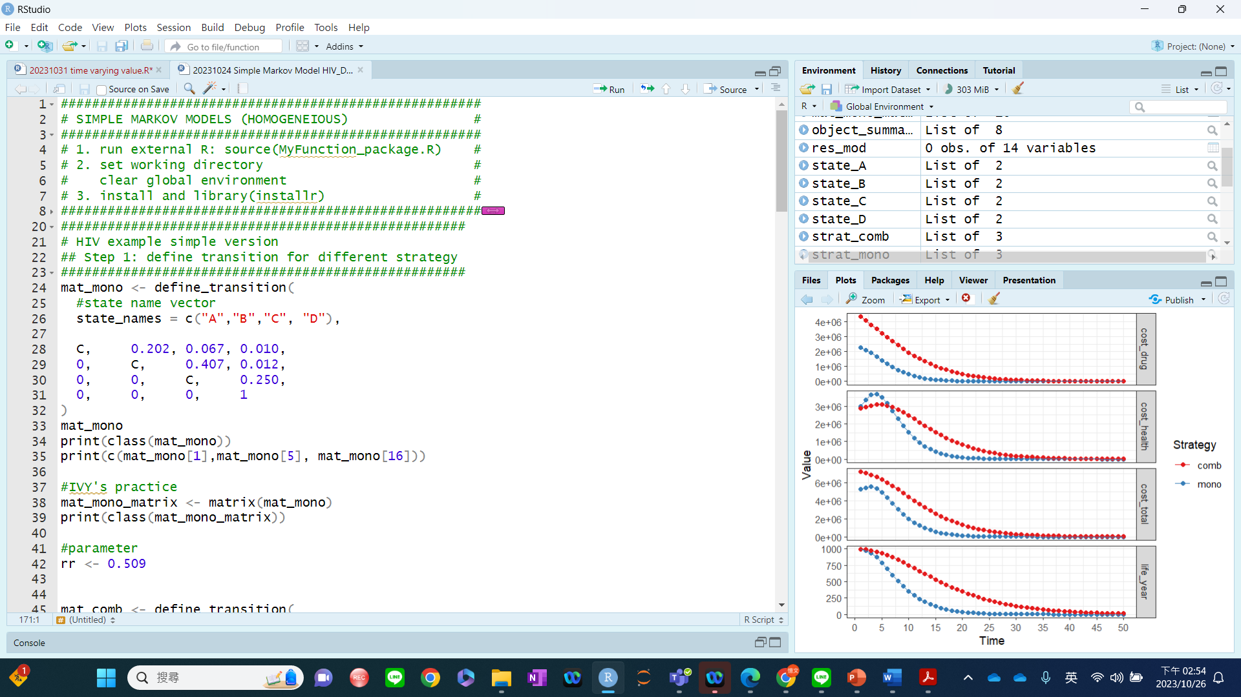
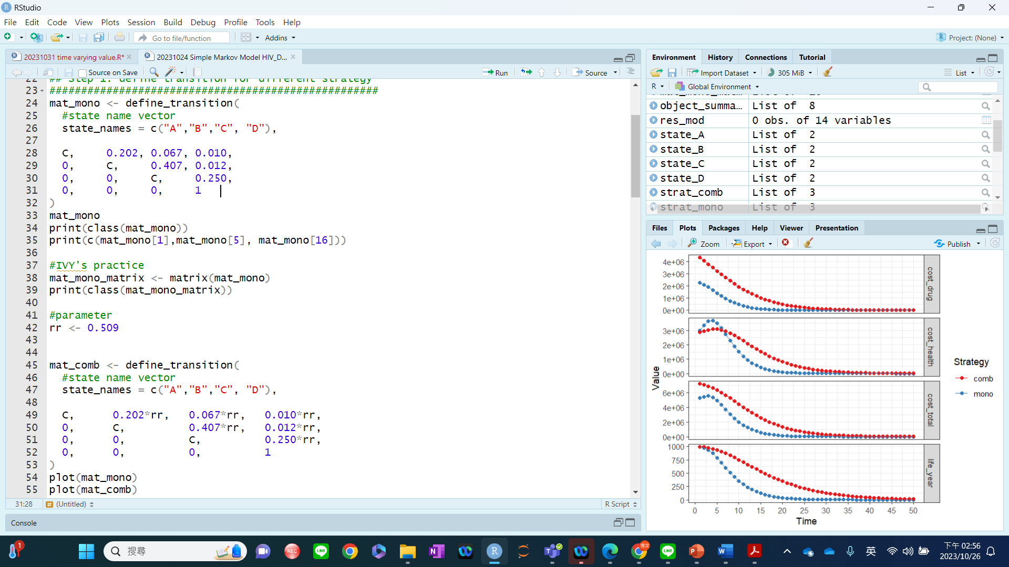

Slide 4
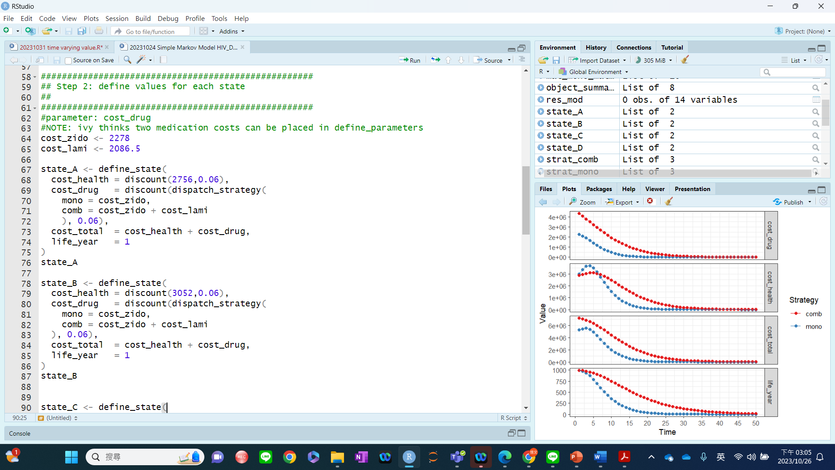

Slide 5
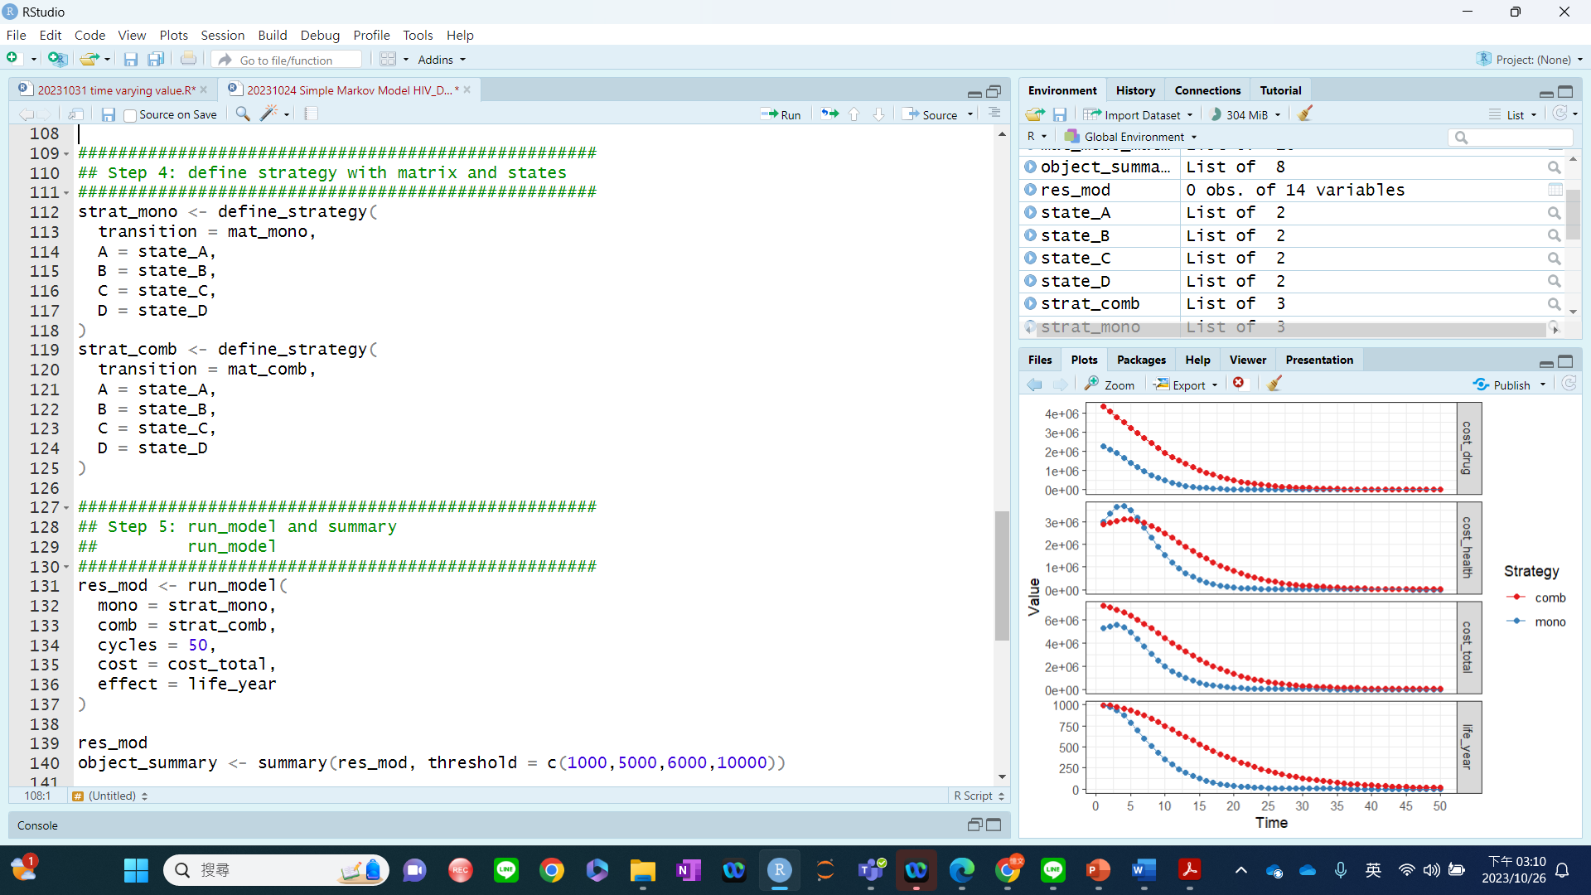

Slide 6
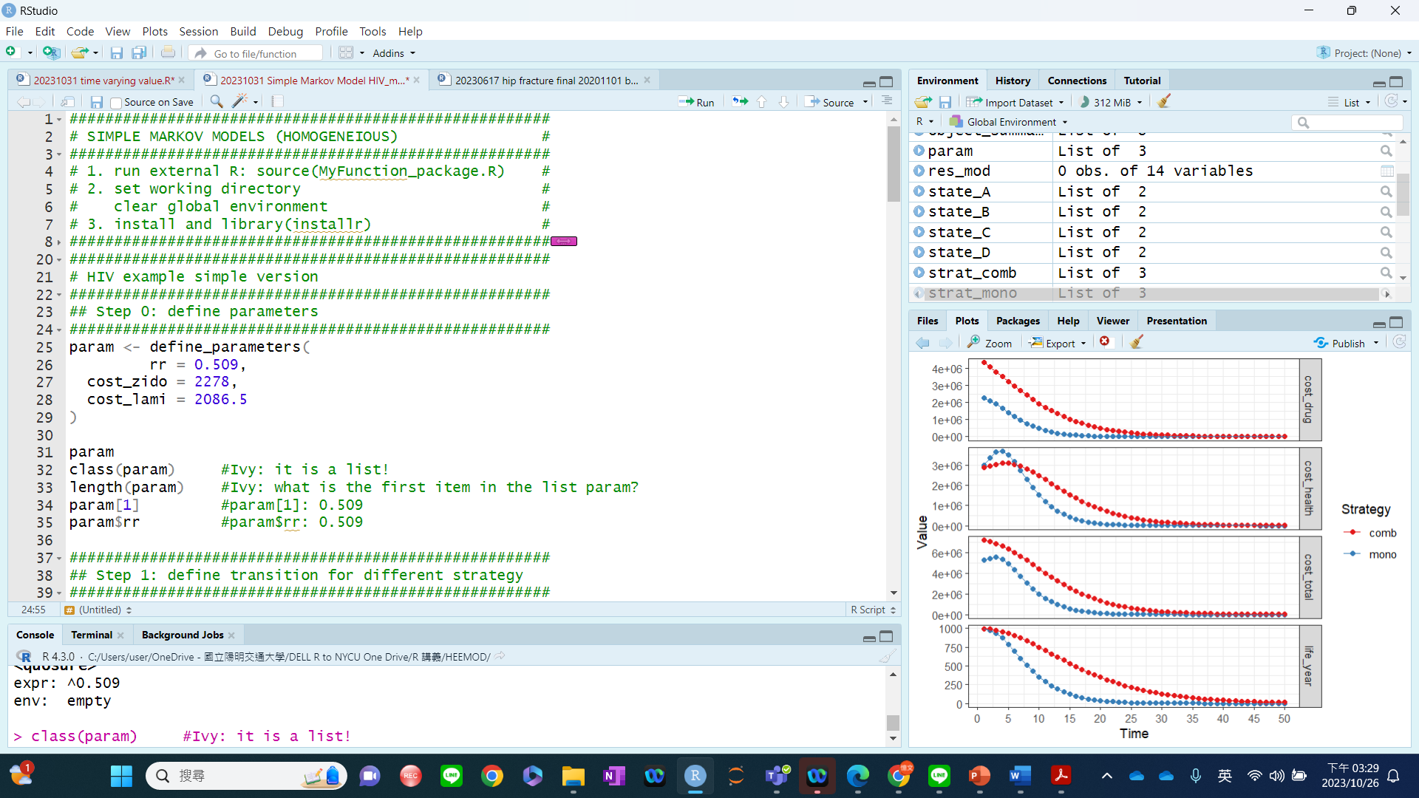

Slide 7
2. Example

Slide 8

Cost-Effectiveness Analysis of Lenvatinib Plus Pembrolizumab in The 2nd Line Treatment for Advanced Endometrial Carcinoma 合併使用Lenvatinib及Pembrolizumab於 晚期子宮內膜癌第二線治療之成本效益分析
Research Proposal
Presenter: Szu-Ting Chiang (蔣思亭)
Advisor: Dr. Yi-Wen Tsai¹ (蔡憶文¹), Dr. Ming-Neng Shiu¹ (許銘能¹), Dr. Wai-Hou Li² (李偉浩²)
Date: October 30, 2023
IRB No: YM111012E
1. National Yang Ming Chiao Tung University; 2. Cheng Hsin General Hospital
Notes:
各位老師、同學大家好，我是碩三的蔣思亭，我的研究題目是，將標靶藥物Lenvatinib合併使用免疫檢查點抑制劑Pembrolizumab用於晚期子宮內膜癌advanced endometrial carcinoma第二線治療的成本效益分析。這個研究是與振興醫院李偉浩醫師合作，已經通過IRB審查。指導教授是：蔡憶文老師及許銘能老師。

Slide 9
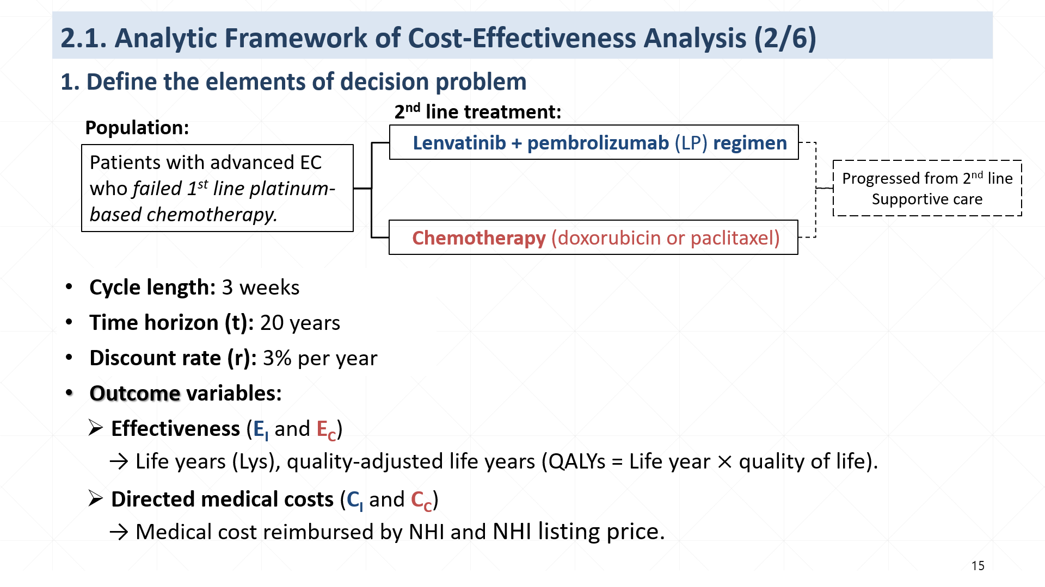

Slide 10
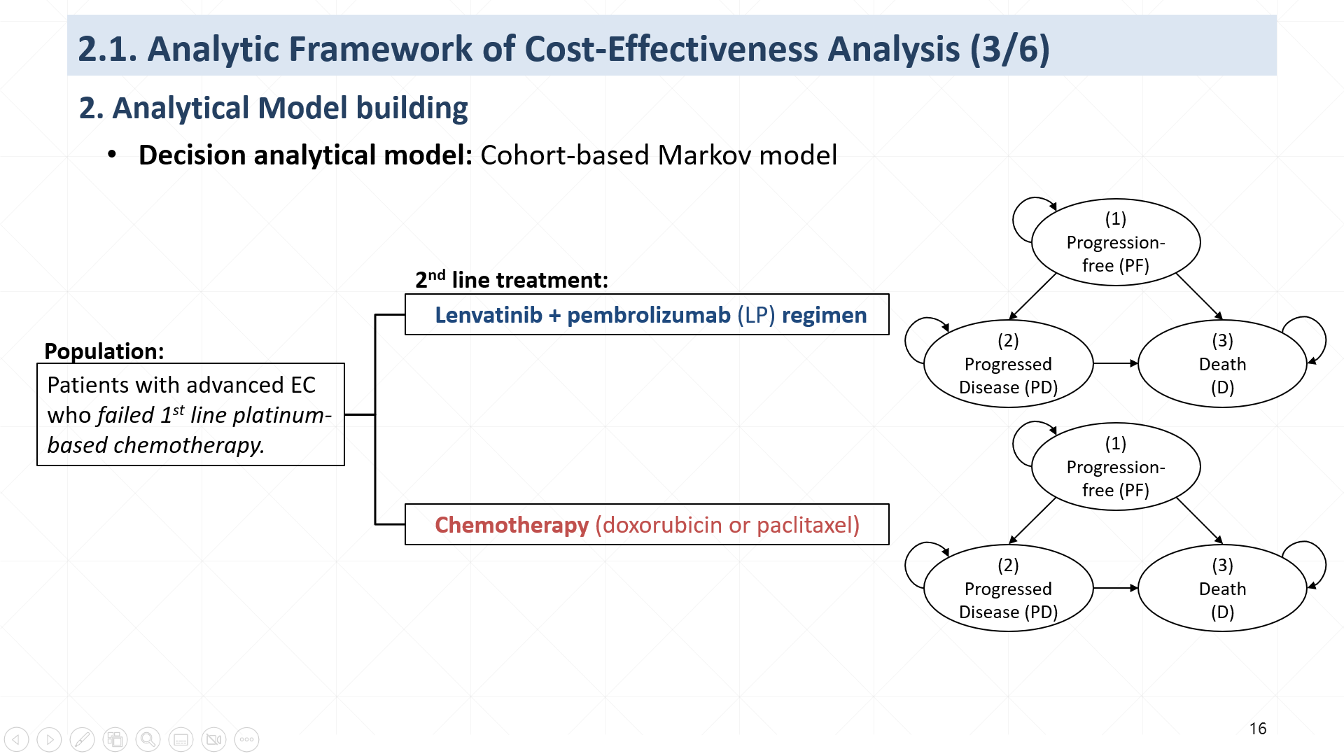

Slide 11
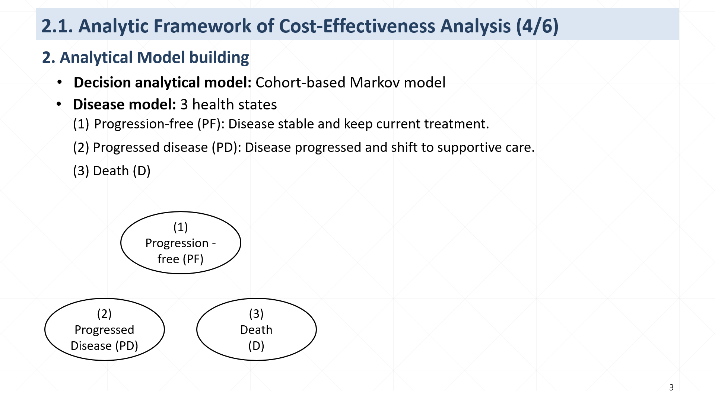

3 health states
1000
(1) Progression-free
(2) Progressed disease
(3) Death
1-p1-p3
(1) Progression -free (PF)
Cycle 0
1000
0
0
tp*=1-p1-p3
p1
p3
Cycle 1
N_{PF1}=1000*(1-p1-p3)
N_{PD1}=1000*p1
N_{D1}=1000*p3
p3
p3
1-p2
p2
1
1-p2
p1
1
1-p1-p3
p1
Cycle 2
N_{PF1}*(1-P1-P3)
[N_{PF1}*p1)]
+[N_{PD1}*(1-p2)]
N_{D1}+(N_{PF1}*p3)
+(N_{PD1}*p2)
(2) Progressed
Disease (PD)
(3)
Death
(D)
p2
…….
…….
…….
…….
T
N_{PF(T-1)}*(1-P1-P3)
[N_{PF(T-1)}*p1)]
+[N_{PD(T-1)}*(1-p2)]
N_{D(T-1)}+(N_{PF(T-1)}*p3)
+(N_{PD(T-1)}*p2)
p = probability
*tp = transition probability
Notes:
Markov model中的疾病模式有三個健康狀態，
第一個健康狀態progression-free state 是指疾病沒有惡化，並且持續接受二線治療方案直到guideline指示的最高總劑量。
第二個健康狀態progressed disease 是指腫瘤惡化，在這state，會終止二線治療，改以症狀控制的支持性療法。
第三個健康狀態是 death 死亡。
我的Markov model ，病患都是從開始接受二線治療的progression free state進入Markov model，
在接受治療的過程中，每經過一個cycle，健康狀態就會隨著轉移機率(transition probability)而改變，
一直到完成time horizon

Slide 12
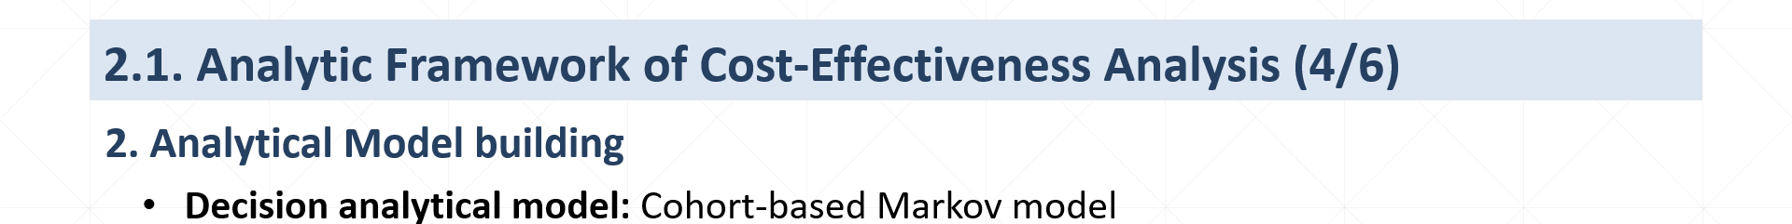
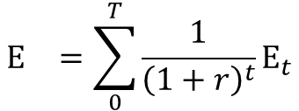
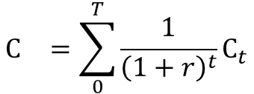
2. Analytical Model building
Decision analytical model: Cohort-based Markov model
Cumulated outputs: E_{I,} E_{C,} C_{I,} and C_{C}
$$E_{}^{}=\sum_{0}^{T}{{\frac{1}{{\left(1+r\right)}^{t}}\text{E}}_{t}}$$
$$C_{}^{}=\sum_{0}^{T}{{\frac{1}{{\left(1+r\right)}^{t}}\text{C}}_{t}}$$
Cycle | Effectiveness (E) (Unit: LYs, QALYs*) | Cost (C) (Unit: NTD)
0 | E₀ ₌ E_{PF0} | C₀ = C_{PF0}
1 | E₁ = E_{PF1} +E_{PD1} | C₁ = C_{PF1}+ C_{PD1}+C_{D1}
2 | E₂ = E_{PF2} +E_{PD2} | C₂ = C_{PF2}+ C_{PD2}+C_{D2}
……. | ……. | …….
T | E_{T} = E_{PFT} +E_{PDT} | C_{T} = C_{PFT}+ C_{PDT}+C_{DT}
3 health states
(1) Progression-free
(2) Progressed disease
(3) Death
Cycle 0
1000
0
0
Cycle 1
N_{PF1}
N_{PD1}
N_{D1}
Cycle 2
N_{PF2}
N_{PD2}
N_{D2}
…….
…….
…….
…….
T
N_{PFT}
N_{PDT}
N_{DT}
*LYs = life years, QALYs = quality-adjusted life years.
Notes:
接下來要介紹估算effectiveness及medical cost 的方式，
隨著cycle的累進，健康狀態的轉變，我會估算每個cycle下的effectiveness和cost
經過3% discount，最後一起加總，估計出intervention組20年time horizon累計的cumulative effectiveness及cumulative cost還有comparator組累計的cumulative effectiveness及cumulative cost，分別就是EI EC CI和CC

Slide 13
3. Time variables in heemod

Slide 14

Two stopwatches in heemod
model_time: time during the time_horizon
state_time: time during the state
Five steps in the simple Markov model are……..
define_parameters
define_transitions
define_strategy
define_strategy
define_state
At which stages do we use time variables to define objects?

Slide 15
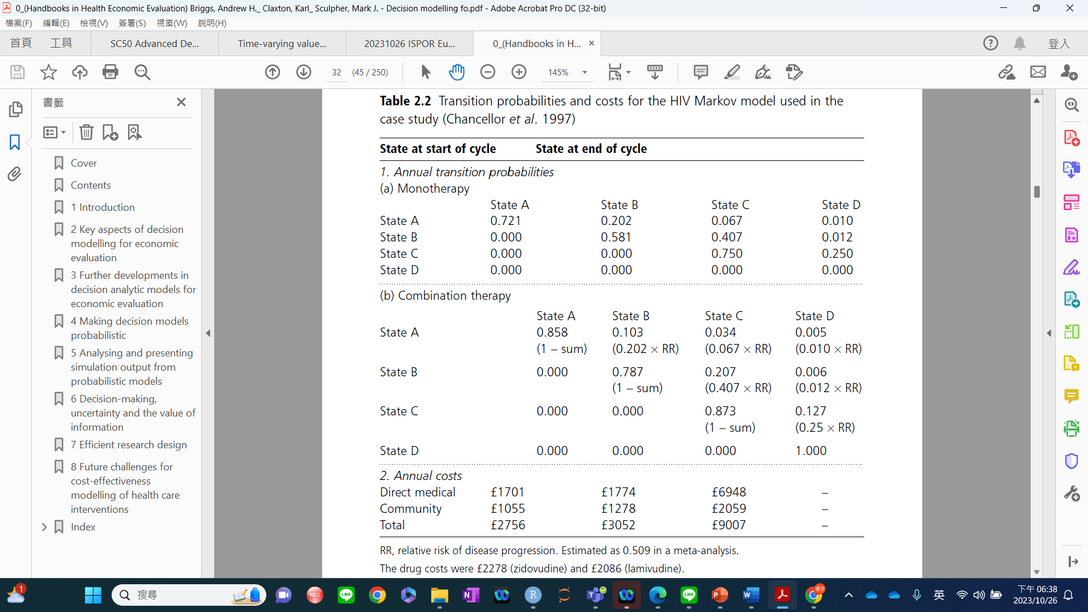
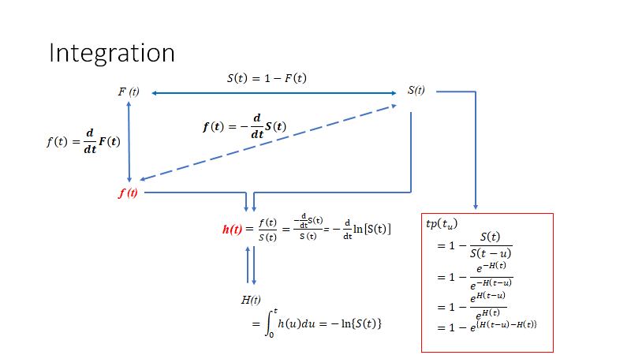
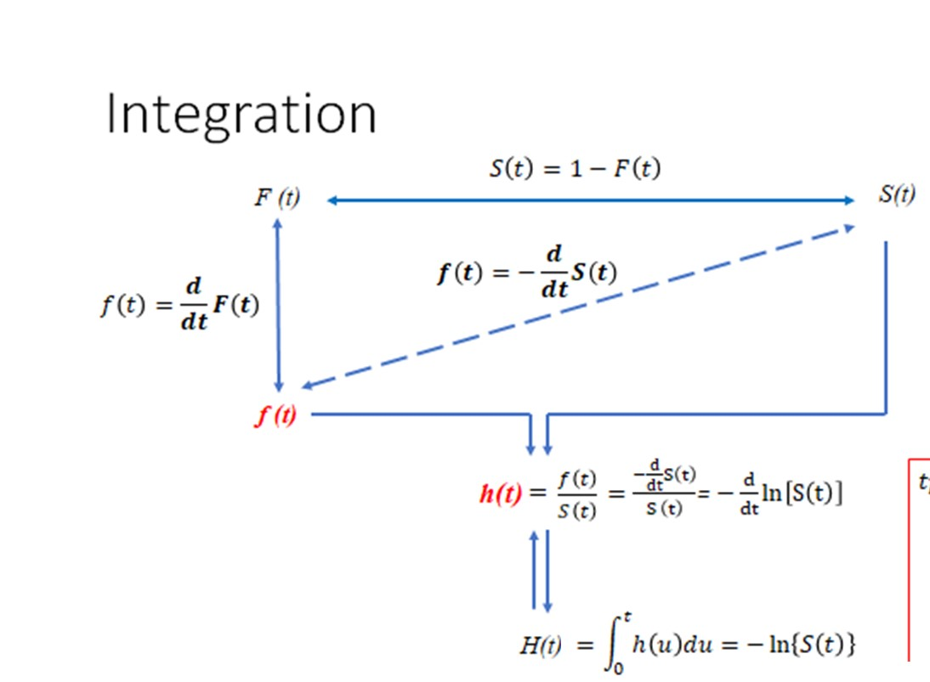


HIV case study-model parameters
In other words, which model inputs are time-dependent and, thus, could be expressed as functions of time?
Costs (first two years?) and utility(maybe?)
Transition probabilities!
$$S\left(t\right)=e^{−H\left(t\right)}$$
$$h\left(t\right)= ?$$

Slide 16
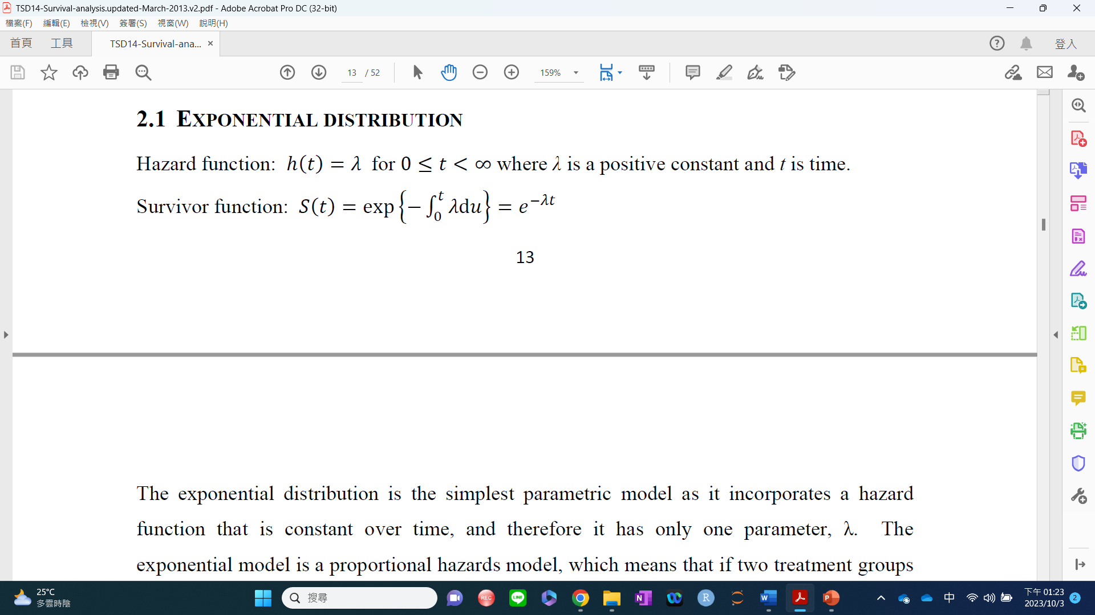
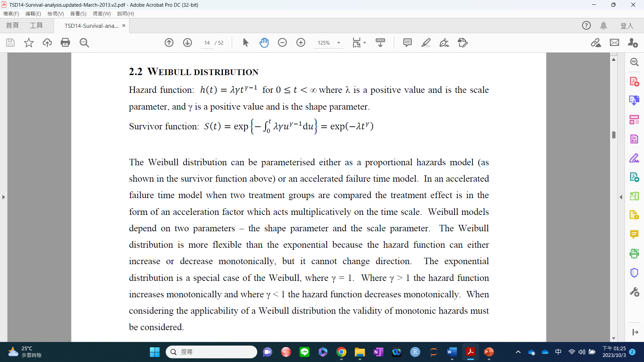
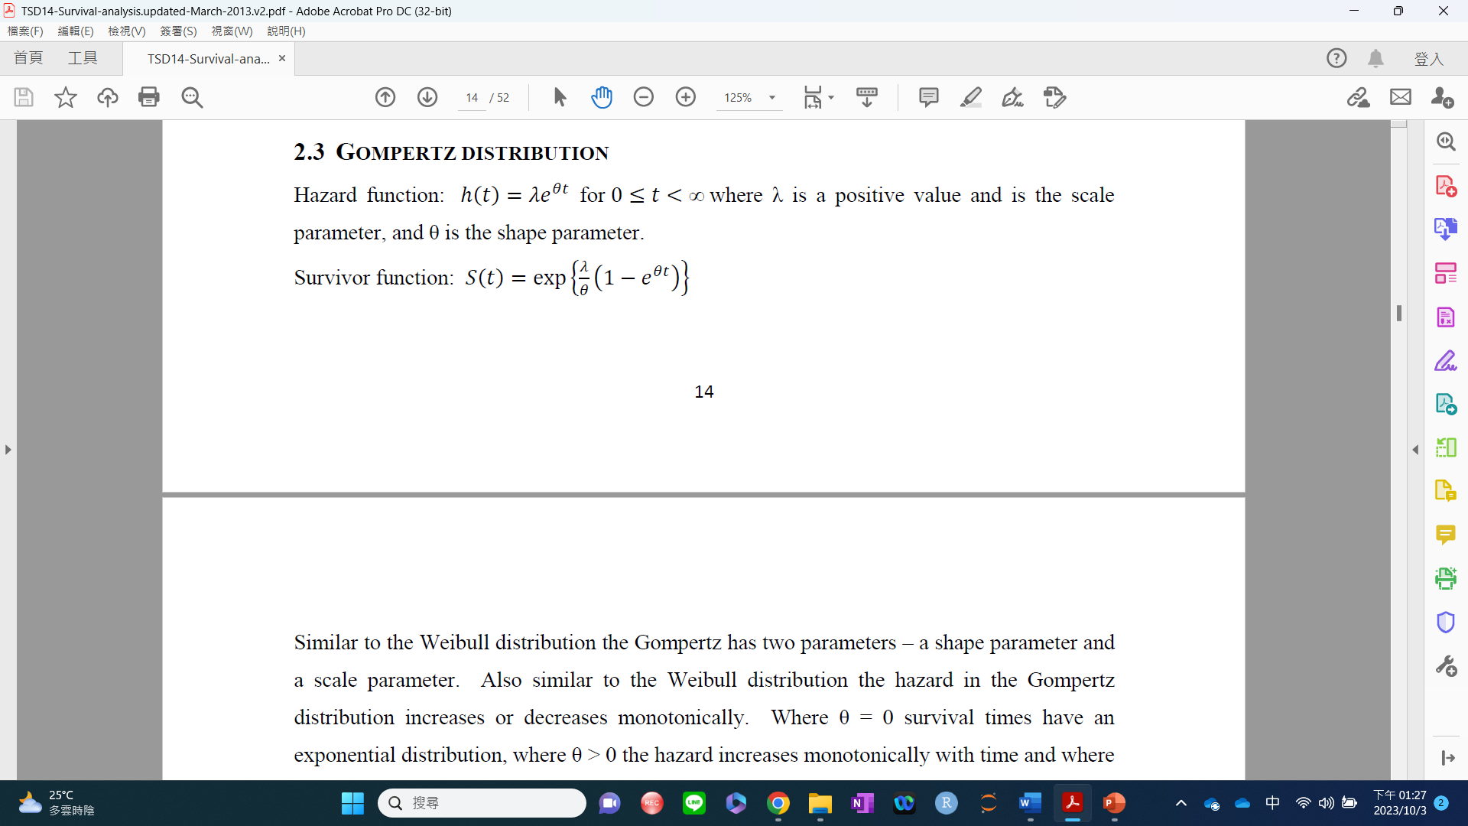

Slide 17

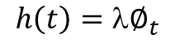
HIV case study-model parameters
In other words, which model inputs are time-dependent and, thus, could be expressed as functions of time?
Costs (first two years?) and utility(maybe?)
Transition probabilities!
$$S\left(t\right)=e^{−H\left(t\right)}$$
$$h\left(t\right)= ?$$
$$h\left(t\right)=λ∅_{t}$$
$$= ?$$

Slide 18
HIV case study-model parameters
In other words, which model inputs are time-dependent and, thus, could be expressed as functions of time?
Costs (first two years?) and utility(maybe?)
Transition probabilities!
$$S\left(t\right)=e^{−H\left(t\right)}$$
$$h\left(t\right)= ?$$
$$h\left(t\right)=λ∅_{t}$$
$$= ?$$
$$\text{Constants}\text{, }\text{which} \text{are} \text{determined} \text{by} \text{time}\text{−}\text{varying} \text{X}\text{.}$$

Slide 19
Two stopwatches in heemod
model_time: time during the time_horizon
state_time: time during the state
Which time variable?
Input | model_time | state_time
Age(t)
Utility (t)
Cost(t)
Natural mortality
S(t)
h(t)

Slide 20
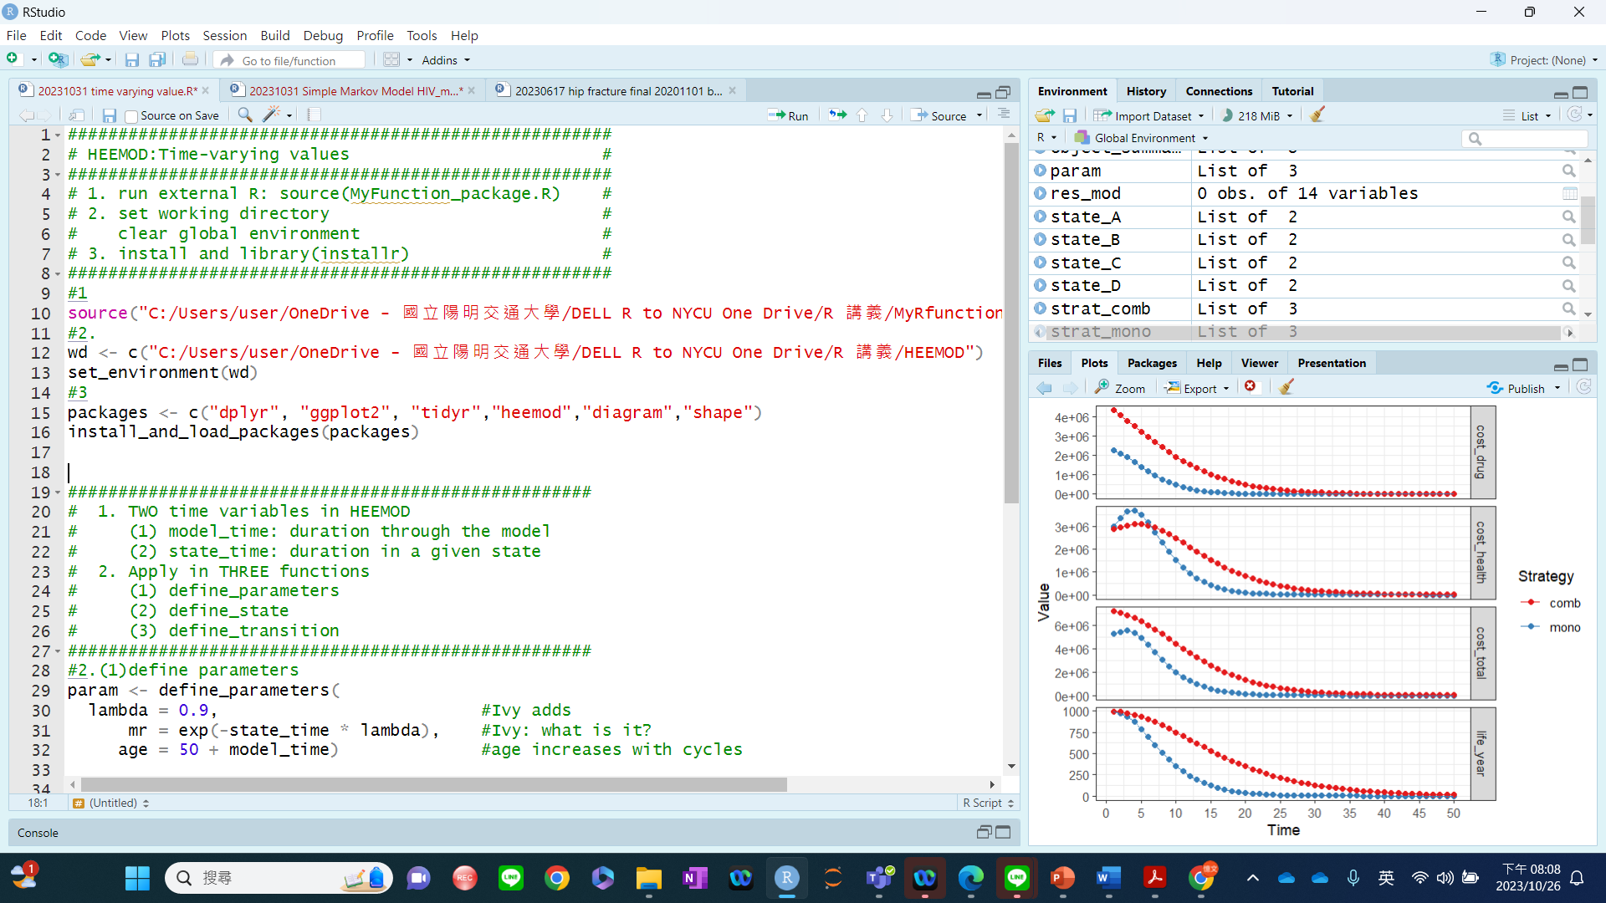

Slide 21
